Slide 1

Marketing the Ford Ka
Compare Clustering Solutions
Demographics versus Psychographics

Slide 2
1. Summary of the psychographic data (not all of it, just a plot or two, or summary statistics that you think are quite instructive/insightful/illustrative)
2. Summary of your k-means. Please do not just show just the centroids but what you learn from the centroids and how they help you understand/summarize the data. Give your centroids names and/or images to help identify them.
3. How do you know your cluster is a good one? (specifically what type of validation did you do to show it is good?)

Slide 3
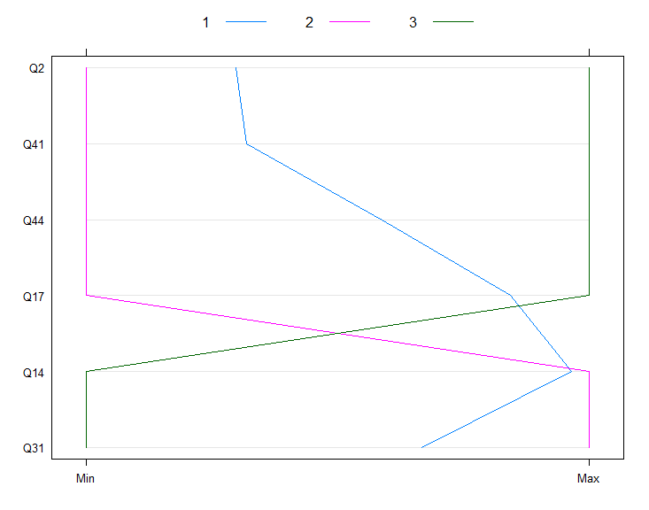
Visualizing our Data
Survey Groups:
Top 3 (Buyers)
Bottom 3 (Non-buyers)
Middle 4 (Fence)
We find some interesting patterns in the data:
Survey participants that ranked the Ford Ka among their top 3 options were looking for performance and were not as concerned with fashion or car-size
Those who
Versicolor’s are in between, but are more like Virginica’s than Setosa’s
Q2. I am fashion conscious.
Q14. The car I buy must be able to handle long motorway journeys.
Q17. I want a car that is nippy and zippy.
Q31. I want a comfortable car.
Q41. In today's world it is anti-social to drive big cars.
Q44. I want to buy a car that makes a statement about me.

Slide 4
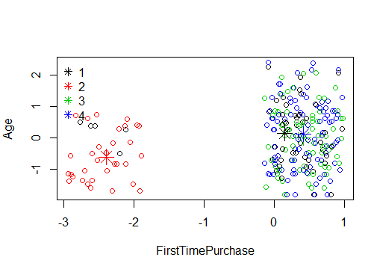
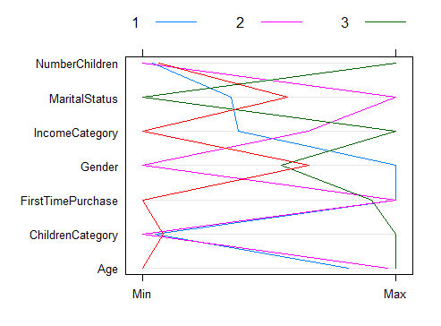
Demographic Data

Slide 5

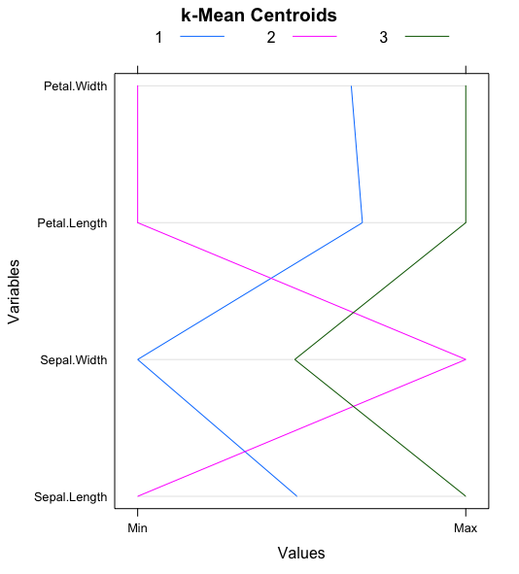
Customer Segmentation
What are your clusters?
What do your clusters mean?
Cluster | Meaning
1 | Long petaled flowers best for hillsides
2 | Medium flowers useful for massing
3 | Small flowers great near homes
State this in plain words that non-technical users can understand. Try using pictures or labels to summarize each cluster.
Experiment with tables and graphs to illustrate and contrast the clusters

Slide 6
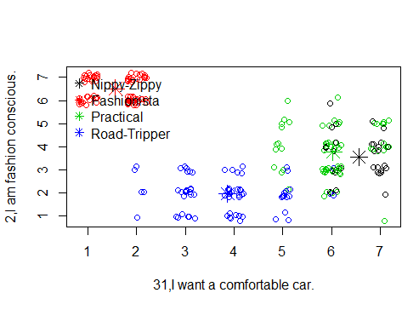
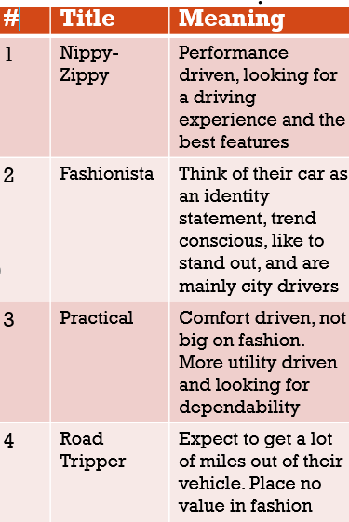
What do the clusters mean?

Slide 7
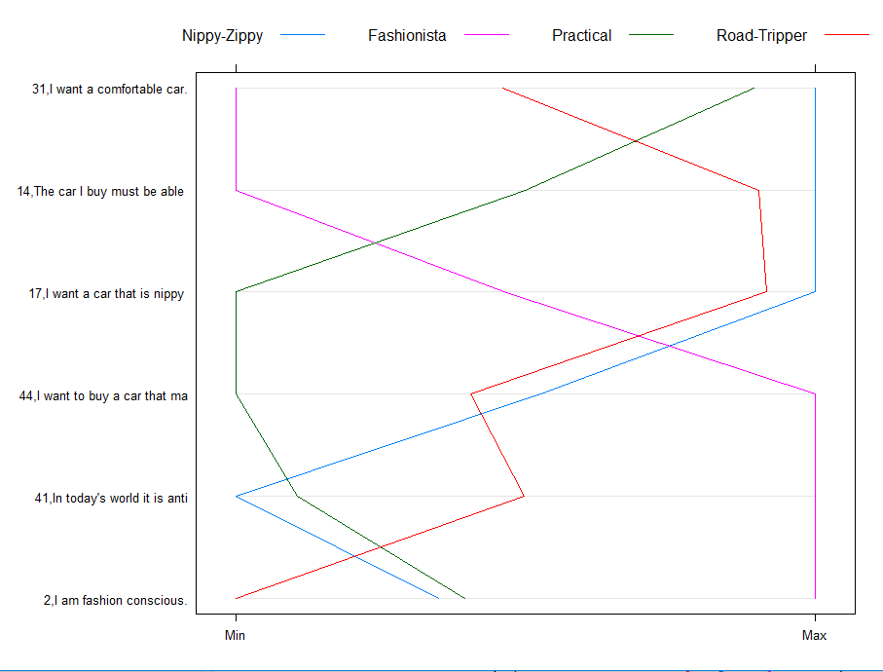
What do the clusters mean?

Slide 8
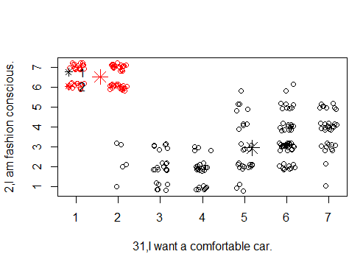
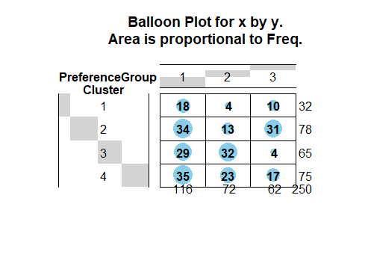

Slide 9
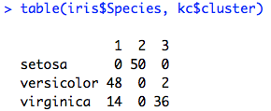
Recommendation of Clustering Solution
There is a strong association between the cluster solution and the species of Iris.
Our confusion matrix shows a strong relationship between “1” and versicolor, “2” and setosa, and “3” and virginica
The validity of our clustering solution is demonstrated by our ability predict the taxonomy developed by expert botanists.

Slide 10
Recommendation of Clustering Solution
There is a strong association between the cluster solution and the species of Iris.
Our confusion matrix shows a strong relationship between “1” and versicolor, “2” and setosa, and “3” and virginica
The validity of our clustering solution is demonstrated by our ability predict the taxonomy developed by expert botanists.

